Slide 1
Indian agriculture analysis project
By Kevin Sifuma

Slide 2
Project Overview
This project aims to conduct a comprehensive analysis of Indian agriculture, focusing on district-wise and year-wise data. It used a dataset containing detailed information on various crops, their areas, production, and yields across different districts and years.
The project uses Power BI to create interactive visualizations to uncover trends, patterns, and disparities in agricultural practices. These insights will enable stakeholders to make informed decisions for sustainable farming and resource allocation.

Slide 3
Project Workflow
Understanding the business problem
Data collection
Data Preparation
Data Analysis
Results Interpretation

Slide 4
Project Objectives
1. Data Exploration: Explore the dataset to understand the distribution of agricultural variables across districts and years.
2. Crop-specific Analysis: Analyze the trends in the cultivation of major crops, including rice, wheat, and pulses, focusing on changes in area, production, and yield.
3. Regional Disparities: Identify disparities and variations in agricultural practices and outcomes across different districts and states.
4. Seasonal Patterns: Explore seasonal patterns in crop cultivation, considering kharif and rabi seasons.
5. Impact of External Factors: Investigate the impact of external factors like weather conditions on crop performance.
6. Fruits and Vegetables Analysis: Analyze the cultivation trends of fruits, vegetables, and their overall contribution to agricultural practices.
7. Sustainable Farming Insights: Derive insights that can contribute to promoting sustainable farming practices and optimizing resource allocation.

Slide 5
Preparation
Here are the steps I performed before I started working on the questions.
Data collection – downloaded the dataset from Kaggle.com
Saved the file as .xlxs to perform some cleaning.
Removed columns that wouldn’t help in the current project.
Enriched the data by extracting the year from the date column more efficient analysis. (Used the YEAR() function in Excel.
Confirmed the data was ready for analysis before importing it to power bi.

Slide 6
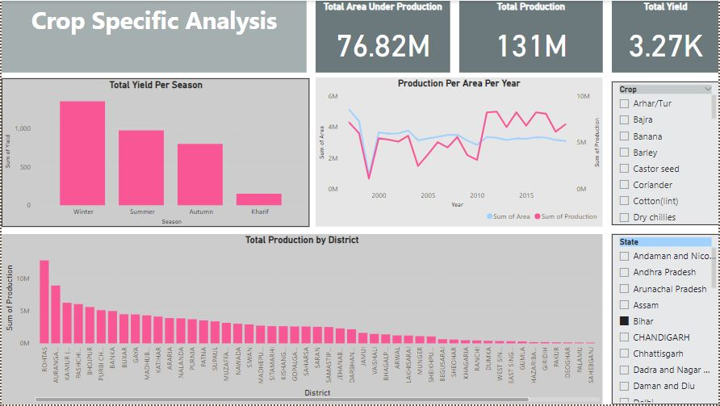
Crop specific analysis

Slide 7
Insights from crop specific analysis dashboard
From this dashboard we can view the following for each crop (the interactive dashboard allows users to filter results per crop and state):
Total yield per season
Total production per year
Area used for production
Total production per district
By using these metrics, it is evident that every crop has its season. It also shows that area of cultivation is directly proportional to production.
However, certain areas remain undercultivated even during peak seasons for crops in season.
The Indian agriculture sector can maximize their production by investing in cultivating larger areas for the crops in season especially IN DISTRICTS THAT ARE UNDERCULTIVATED.

Slide 8
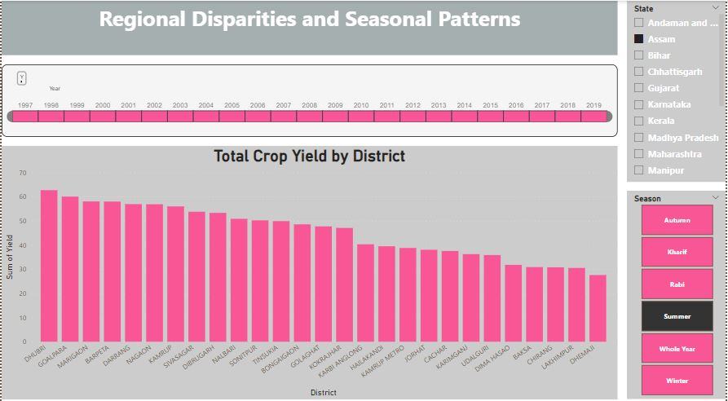
Regional Disparities

Slide 9
INSIGHTS FROM REGIONAL DISPARITIES
THIS INTERACTIVE DASHBOARD SHOWS TOTAL PRODUCTION PER DISTRICT THROUGHOUT THE YEARS BETWEEN 1997 TO 2020
FROM THIS DASHBOARD, WE CAN LOOK AT THE PRODUCTION POWER OF EACH STATE DISTRICT-WISE AND YEAR-WISE.
WHEN YOU FILTER THROUGH THE YEARS YOU’LL DISCOVER THAT CERTAIN DISTRICTS ARE ALWAYS ON TOP IN TERMS OF PRODUCTION WHILE OTHERS ARE ALWAYS ON THE BOTTOM. THIS IS DEPSITE OF THE SEASON.
IN THIS REGARD, THE SECTOR CAN TAKE MEASURES TO HELP BOOST THE PRODUCTIVITY OF THESE DISTRICTS WHICH WILL INTURN BOOST THE NATIONAL PRODUCTION.

Slide 10
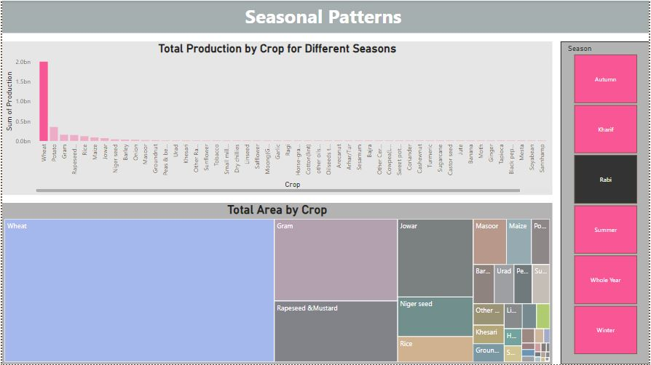
Seasonal Patterns

Slide 11
INSIGHTS FROM SEASONAL PATTERNS DASHBOARD
THIS DASHBOARD ALLOWS THE STAKEHOLDERS TO CHECK WHETHER THEY ARE MAXIMIZING ON PRODUCTION.
WHEN YOU FILTER BY THE SEASONS, YOU’LL BE ABLE TO COMPARE THE TOTAL AREA OF THE CROP AND THE TOTAL PRODUCTION.
FROM THIS DATA, THE STAKEHOLDERS WILL DISCOVER WHERE THEY NEED TO CULTIVATE MORE AND WHERE THEY NEED TO IMPLEMENT EFFICIENT PRODUCTION METHODS TO MAXIMIZE PRODUCTION.

